Slide 1
Heuristics/Turing Machines

Slide 2
Heuristics
There are many problems that are considered intractable - This means that no algorithm exists that can solve them in a reasonable amount of time (years or less, depending on the problem).
One such problem is the travelling salesperson problem. A salesperson needs to visit n towns but the problem is which route, visiting all of the towns and then returning to the starting point will cover the least distance?
WIth 30 cities, there are 2652528598121910586363084800000000 combinations. It would required a computer many millions of years to check all of these.

Slide 3
Heuristics
Often a heuristic is used to solve problems such as this. A heuristic algorithm is not guaranteed to return the exact answer but one that is sufficient.
It is thought of as a “rule of thumb” or educated guess which allows us to produce an approximate but useable solution to a problem.
They are strategies derived from previous experiences with similar problems.
They are suitable when finding an optimal solution is impractical or impossible.

Slide 4
Heuristics are not guaranteed to be optimal (but usually take less time than would be required to find an optimal solution).
Limitations lie in the trade-offs e.g. correctness vs. performance. Suitable when finding an optimal solution is impractical or impossible.

Slide 5
Machine Learning
In 1936, Alan Turing invented a mathematical model of a universal machine, which later became known as a Turing Machine.
This is often considered the foundation for the development of Computer Science and Machine Learning.

Slide 6
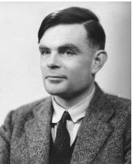
Turing Machine
The machine came about when Alan Turing, a mathematician was studying the limits of maths and what could be computed using maths. He defined a device - a Turing Machine. Anything that is possible to mathematically compute could be programmed on a Turing Machine.
The operation is a simple concept but can be constructed to solve any given computer algorithm.

Slide 7
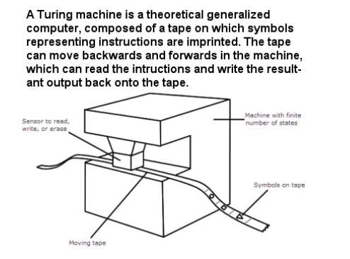

Slide 8
Turing Machine
Modern computers work differently than Turing’s machine, but are mathematically equivalent
All computers, from the ones in your microwave to your PC have the same basic abilities. It is possible to run any program on any computer, but it might mean you have to do a lot of programming to make it work. It does not mean that we can solve all problems on any computer.
One of the important things that Turing proved is that some problems can’t be solved by computers at all.

Slide 9
Turing Machine
The Turing Machine didn’t actually know anything about numbers even though it was a device that could do mathematical computation.. It could simply make marks on a piece of paper tape, and then count those marks to be able to do mathematics.
Electronic computers aren’t much better with numbers - they count using patterns of voltages (on/off). But instead of users having to deal with these patterns, the operations are already programmed into the computer.
When you work with a computer, you have a range of abilities already built in by others. The computer already knows how to deal with numbers, operation and other things.
At the basic level though, even the most powerful supercomputer cannot solve problems better than a Turing Machine!

Slide 10
https://youtu.be/2cBLSPfhUXE

Slide 11
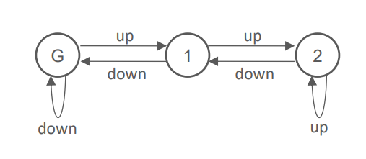
Turing Machines
This diagram is of an elevator represented as a finite state machine.
The circles represent states (floors)
Arrow represent transitions between states
The labels on each transition represent the button press event

Slide 12
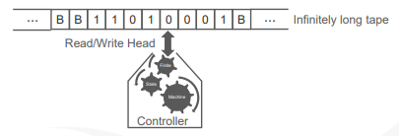
Turing Machines
A Turing Machines consist of three components as follows:
An infinitely long tape made up of individual cells. Each cell can contain a single character - typically 1, 0 or B (blank)
A read/write head pointed at an individual cell
A controller (finite state machine) which instructs the read/write head what to do.

Slide 13
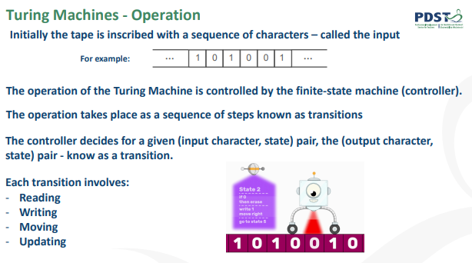

Slide 14
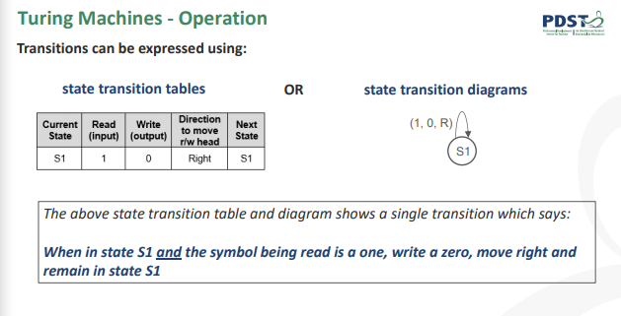

Slide 15
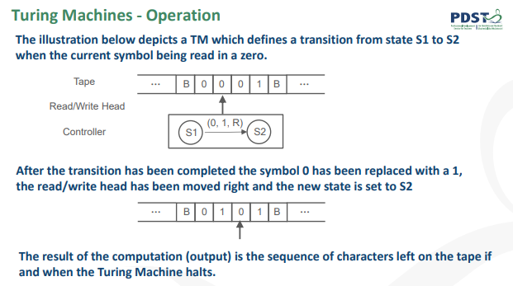

Slide 16
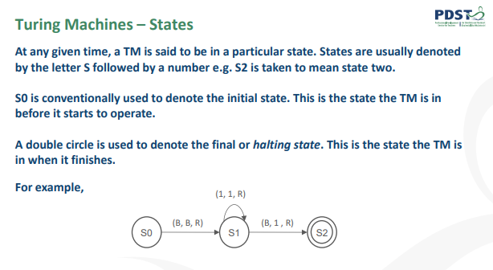

Slide 17
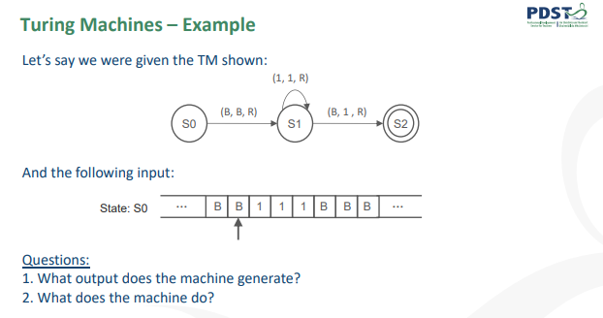

Slide 18
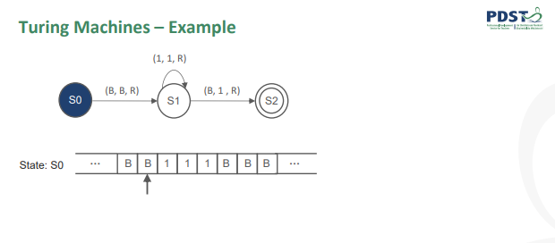

Slide 19
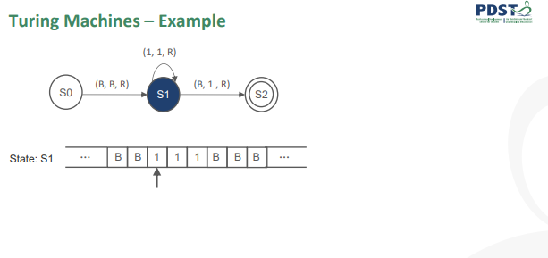

Slide 20
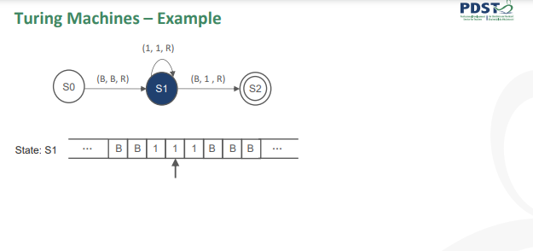

Slide 21
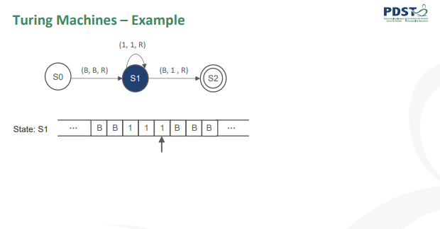

Slide 22
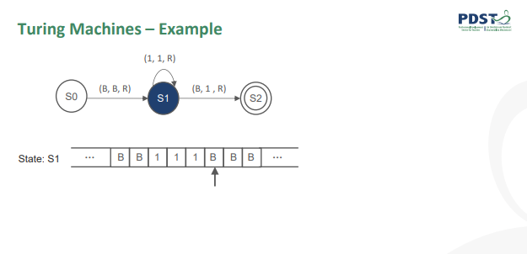

Slide 23
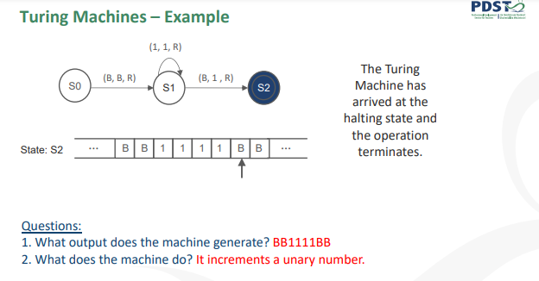

Slide 24
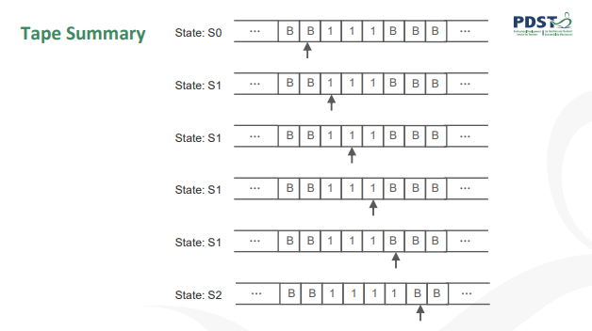

Slide 25
Significance of Turing Machines
Turing Machines can define computability - It is a model of computation.
A task is computable if it can be carried out by a Turing Machines
A Turing machine can compute anything that is possible to be computed.

Slide 26
Demonstration - addition of two numbers
The Turing Machine shown on the next slide consists of tape comprising of a number of cells. A read/write head points to a particular cell at any given time.
There are only 3 operations that can be performed on the tape:
Read the value
Write a new value (0,1, BLANK)
Move the read/write head to the next cell.
The # symbol will be interpreted in this case as ADD. The machine itself is oblivious to the symbol, as the algorithm is deciding that # means addition.
We want our execution of the algorithm to add 2 + 3 to end with five 1’s in a row, bookended by BLANKS.

Slide 27
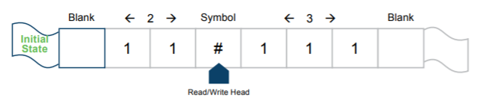
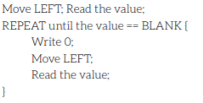



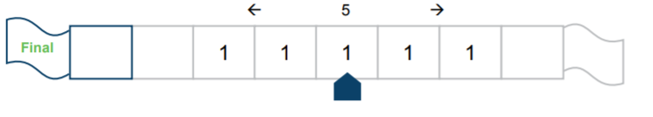
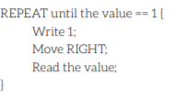

Slide 28
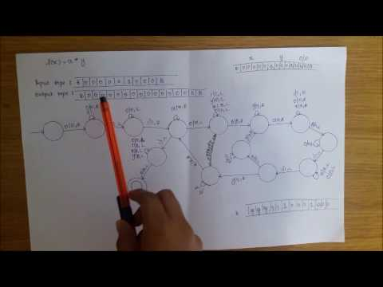
Adding on a Turing Machine

Slide 29
